Slide 1

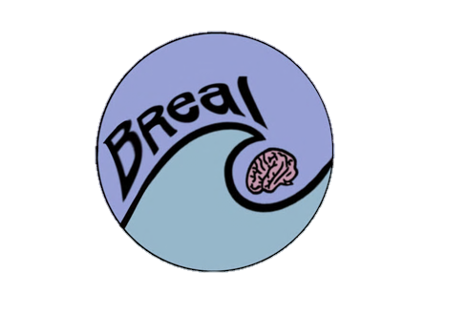
Building stress resilience in early adolescents’ lives

Slide 2

LESSON 3
Baseline –
Student Questionnaire
Turn to the "Lesson 3 Baseline: Student Questionnaire" on your Lesson 3 worksheet and complete this independently. You will not be asked to share your answers.

Slide 3

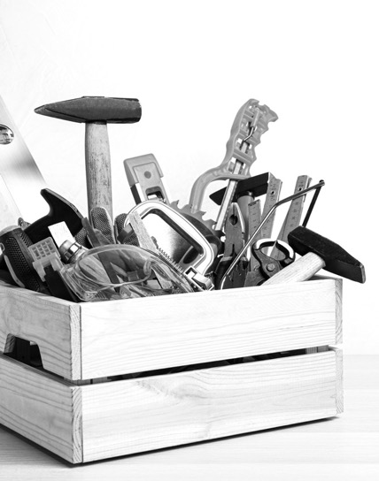
Building a stress toolbox
This multi-lesson course is on STRESS
and how to deal with it.
Throughout these lessons we will …
Explore: what stress is and how people respond to it
Discover: stress isn’t always bad!
Challenge: ourselves to respond well to it
Learn: new ways to respond to stress
Practice: being brave
Notes:
Welcome to the third and final lesson of the BReal course. These resources were put together by a group of neuroscientists, clinical psychologists, public engagement specialists and teachers. BReal aims to engage young teenagers and equip them with the knowledge and practical skills to drive their own brain development in a positive direction that promotes good mental health. The project aims to inform, inspire and empower teenagers to cultivate stress resilience skills and thus enable them to better manage their own minds.

Slide 4
Ground Rules
It is important that ground rules are in place to create a safe learning environment that enables everyone to learn effectively. Let's establish ground rules as a class.
For example:
Everyone has the right to be heard and respected
We won’t share our own personal experiences
We have the right to pass
What else?

Slide 5
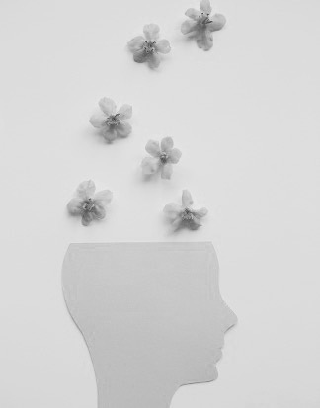
Changing our Stress Response
There are many ways to help deal with stress effectively. The objective of this lesson is to learn how understanding brain development can help our own and each other’s mental well-being. Today we will learn how to:
Explain why personal and social actions make a big difference to our and other’s stress resilience.
Explain how and why social relationships can have a positive and negative impact on stress.
Evaluate personal and social strategies people can use to respond resiliently to stress.
Notes:
Last lesson we looked at how we learn from mistakes as well as successes. We saw how the reward chemical dopamine that makes people feel good is released more during the learning process when people get something right and dips when they get something wrong. We also thought about how the adolescent years are the perfect time to learn from mistakes as they give the front part of the brain, the prefrontal cortex, the strategies it needs in the long term to be flexible and coordinate with the other parts of the brain that support learning more efficiently when practicing. Finally, at the end of the last session we studied how using growth mindset, when we noticed that we were stressed, might change our actions and emotions. Let’s now look further at that idea of change....

Slide 6
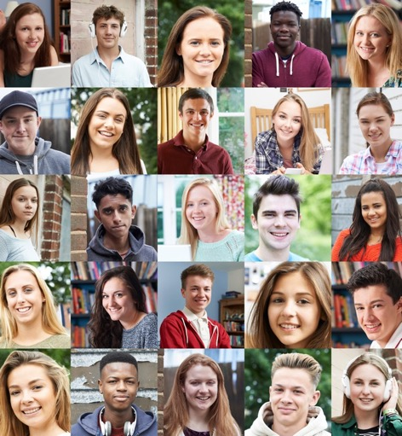
Stress and mistakes
Everyone gets stressed and everyone makes mistakes.
That even includes successful people. Fact.
The stress response is useful, and it is important for people to make mistakes so they can learn from them.
So, learning how to cope with stress effectively – learning how to surf the wave – is essential for staying in the stress sweet spot!
Notes:
Because the stress response is the body's natural response when something inside or outside the body is pushing it off its biological balance, it means that everyone is stressed at some point and everyone makes mistakes. Even those people who come across as very successful. Remember not to believe the picture people paint of themselves on social media! We have learned that the stress response is useful and it is important even when making mistakes; even though it feels like mistakes cause more stress, people can learn from them. Our question for this final lesson is, how can people make sure that they aren’t pushed out of their stress sweet spot?

Slide 7
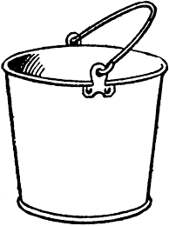
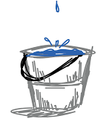

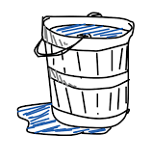


Buckets of Stress Resilience
This is a stress bucket.
Imagine stresses and worries pour in.
Everyone’s bucket can hold different amounts.
But if it reaches the top,
it may feel overwhelming and
hard to manage.
Notes:
A good way to think about managing stress is to imagine that all someone's jobs, responsibilities and stressors are continually pouring into a bucket. This bucket is the capacity that person has for stress. If it reaches the top they get overwhelmed and struggle to manage it all. It’s important to know that everyone has a different bucket which can hold different amounts. But no matter how big the bucket, if all these stressors keep pouring in, an argument with a friend or parent, a mean comment on social media, an upcoming test etc. this bucket can fill up pretty quickly.
What people need are taps to let the stress out. Or a few taps. People who are good at managing their stress have lots of ways to release the stress. These taps represent coping strategies, tricks and tools that support healthy mental wellbeing.

Slide 8

Buckets of Stress Resilience
Taps can let the stress out.
The taps are the coping strategies to support healthy mental wellbeing.
What might they include?
https://vimeo.com/874361569

Slide 9
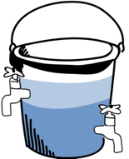
Buckets of Resilience
These activities and habits help the brain circuits function well and support brain plasticity during learning.
Exercise
Starting new activities can feel scary (that's the amygdala talking) but they can make a big difference to mental well-being.
Healthy eating
Enjoyable
activities
Time with friends
& Family
Enough sleep
So it is good to be brave and face fears! Find a good balance between the limbic system and prefrontal cortex.
Sometimes though that bucket will overflow and there is nothing that can be done to stop it, and that is OK and happens to everyone.
Notes:
Some of the activities you might have thought about could have included building connections with people; friends and family, doing what matters to you, and there are many personal actions that you already know about that make a big difference: getting exercise, eating healthily, getting enough sleep. Scientists know that all of these activities help the brain circuits function well and support brain plasticity during learning.
It also might feel scary to start new activities (that’s the amygdala talking). Even though they may seem like small things, they do make a big difference, so keep practicing. Be brave and face those fears and find a good balance between the limbic system and the prefrontal cortex.
But remember, sometimes someone is just going to get wet from their bucket overflowing. They might not have an umbrella at the ready, they may have no tricks or tools to stop this water from drenching them. They know they are just going to have to ride through that shower and there is nothing they can do about it this time round. Sometimes that is going to happen. It doesn't mean they failed – it just happens.

Slide 10
Group work
In groups, using what you learned in the video, write what you know about....
How brains learn from successes and mistakes
What else?

Slide 11
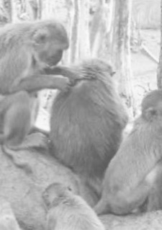
Managing stress in social worlds
Humans are social primates and have the most complex social networks of all primates.
This means that a big part of stress and managing stress comes from people's social experiences.
Notes:
Humans are social primates. They evolved to have the most complex social networks of all primates. This means that a big part of stress and managing stress comes from social experiences. In social groups humans can either compete or cooperate for resources. In the wild that meant fighting over the best cave, but now humans are more likely to compete on what clothes they wear or how many likes they got on Instagram and so on.

Slide 12
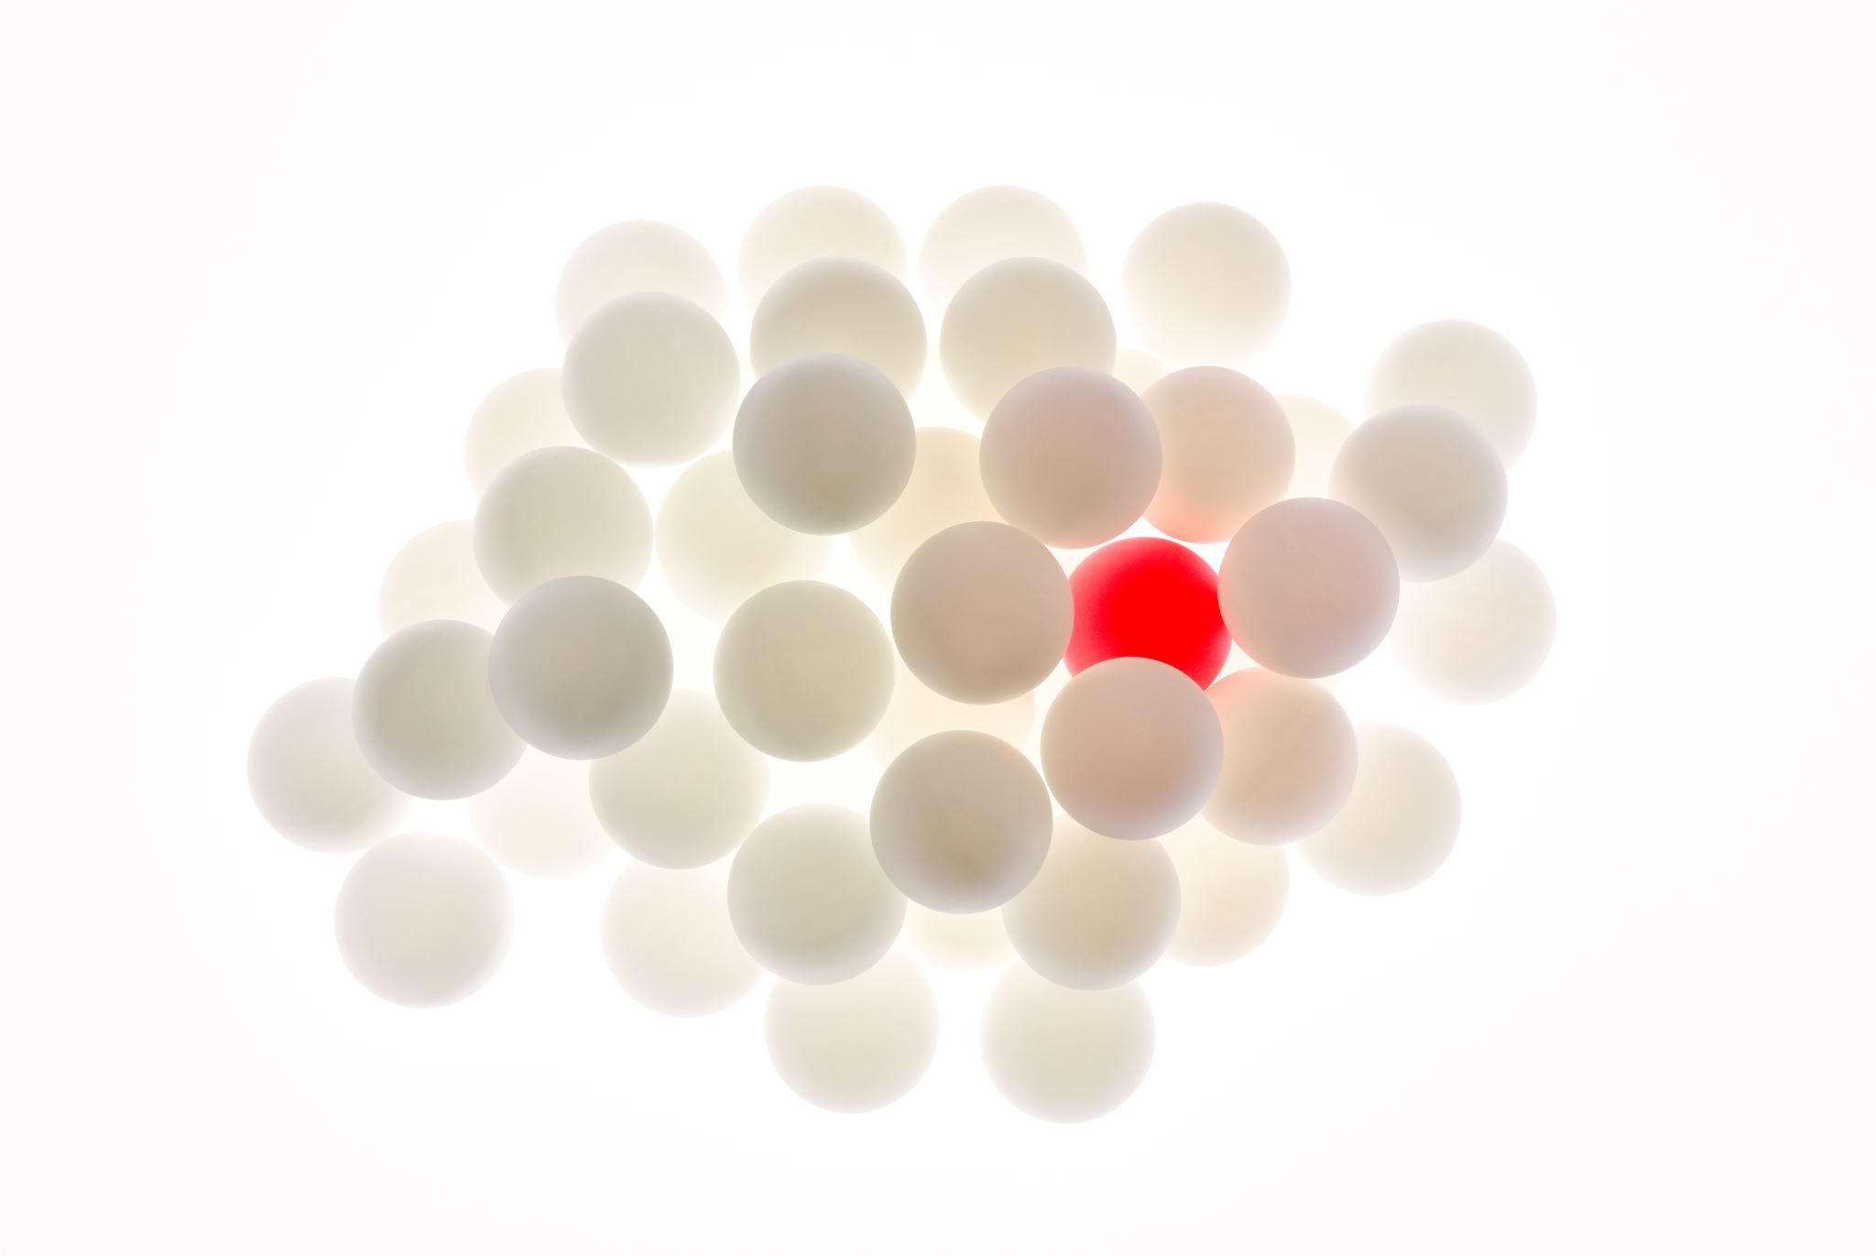
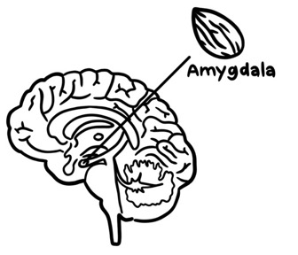
Signaling social threat
In the past, a person's place in a social group was critical to their survival.
Their family and friends fed them when sick or injured and protected them when hunting.
The amygdala sees social isolation as a threat and tells people not to risk their social position.
The amygdala is not wrong, being lonely changes people's brains and affects their physical and mental health.
Prefrontal
cortex
Notes:
In the past, someone's place in a social group was key to their literal survival. Without family and friends to feed them if they got sick or injured, or to watch their back when out hunting they wouldn't make it. While it is less life-or-death now, the amygdala still sees social isolation as a real threat. The amygdala tells people not to do anything to risk their position in their social group. And the amygdala is not wrong, being lonely affects people's physical and mental health. Scientists have shown that when people live alone or in small groups there are big differences in their brains compared to people who live with others. Scientists have also seen that people who live alone or feel lonely are more likely to struggle with mental and physical health problems, like problems with their heart.
Extension: This is likely to be a big problem in the future as more and more people are living alone. Consider the impact of the pandemic on single member households.

Slide 13
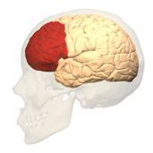
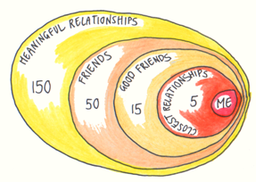


The prefrontal cortex is built for managing social worlds
Did you know the prefrontal cortex might have got bigger across evolution to cope with today's social world?
But bigger social networks aren't always better. Scientists think people can only manage about 150 meaningful relationships, and even fewer close friends.
small
big
Notes:
People's social worlds are both full of stress and support. But a scientific theory suggests that the prefrontal cortex may have become bigger through evolution to deal with more complex social worlds.
However, something worth thinking about is that some social scientists (anthropologists) who study patterns of human behaviour across different cultures believe bigger is not always better. They believe that human brains can only manage about 150 meaningful relationships and within that people typically have far fewer close friends.

Slide 14

Adolescence: why does this matter?
Because now the social influence of peers is really strong which can create challenges for managing stress.
  What if they worry that people will mock them, even ostracize them?
To de-stress, it helps to do enjoyable things and find new ways to be happy, no matter how challenging (like surfing!).
Notes:
During adolescence young people become more independent from their families and rely less directly on their social support. We know that adolescents are really influenced by their peers. And from a scientific perspective this makes complete sense. But it can create a problem in managing stress. To manage stress, people should do things that they enjoy and find new ways of making them happy, no matter how bonkers. But what if they worry that other people will mock them, even ostracize them?

Slide 15
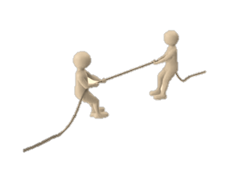
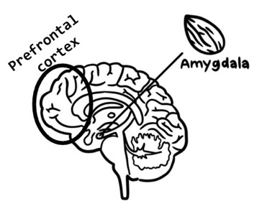
Adolescence:
Finding a balance
The amygdala and prefrontal cortex are in a tug of war. The amygdala 'wants' to keep people safe; the prefrontal cortex 'wants' them to try new things.
The prefrontal cortex is not yet fully developed and can't always control the amygdala. By trying to keep people safe, the amygdala can sometimes prevent people from being fully themselves.
The goal is for young people to find a balance: to be safe and true to themselves; and to not be afraid of trying out new things just because of worry about what other people might think.
Notes:
So here is a tug of war with the amygdala trying to keep people safe and the prefrontal cortex urging people to try new things, and learn though mistakes.
And while the prefrontal cortex may have gotten bigger through evolution to deal with more complex social worlds, as we learned in the first two lessons it is not fully developed in adolescents. This means it can't always control the amygdala and so the amygdala often ends up winning the tug of war with the prefrontal cortex. But by always trying to keep people safe, the risk is that the amygdala ends up creating a little cage where a person feels they can't be who they are or they can't try out new things. People need to find a way to be true to themselves without constantly checking and worrying what other people think. One big area of stress comes from the social world (e.g. peer pressure, relationships with family/friends, romantic relationships, bullying), but social lives are also a huge factor in improving mental well-being. Social isolation is such a threat to human survival that the amygdala sometimes stops people from doing something that might risk them being left out of a social group. But sometimes that means they feel they can’t try new things or be themselves – which makes them more stressed! How can they overcome this?

Slide 16
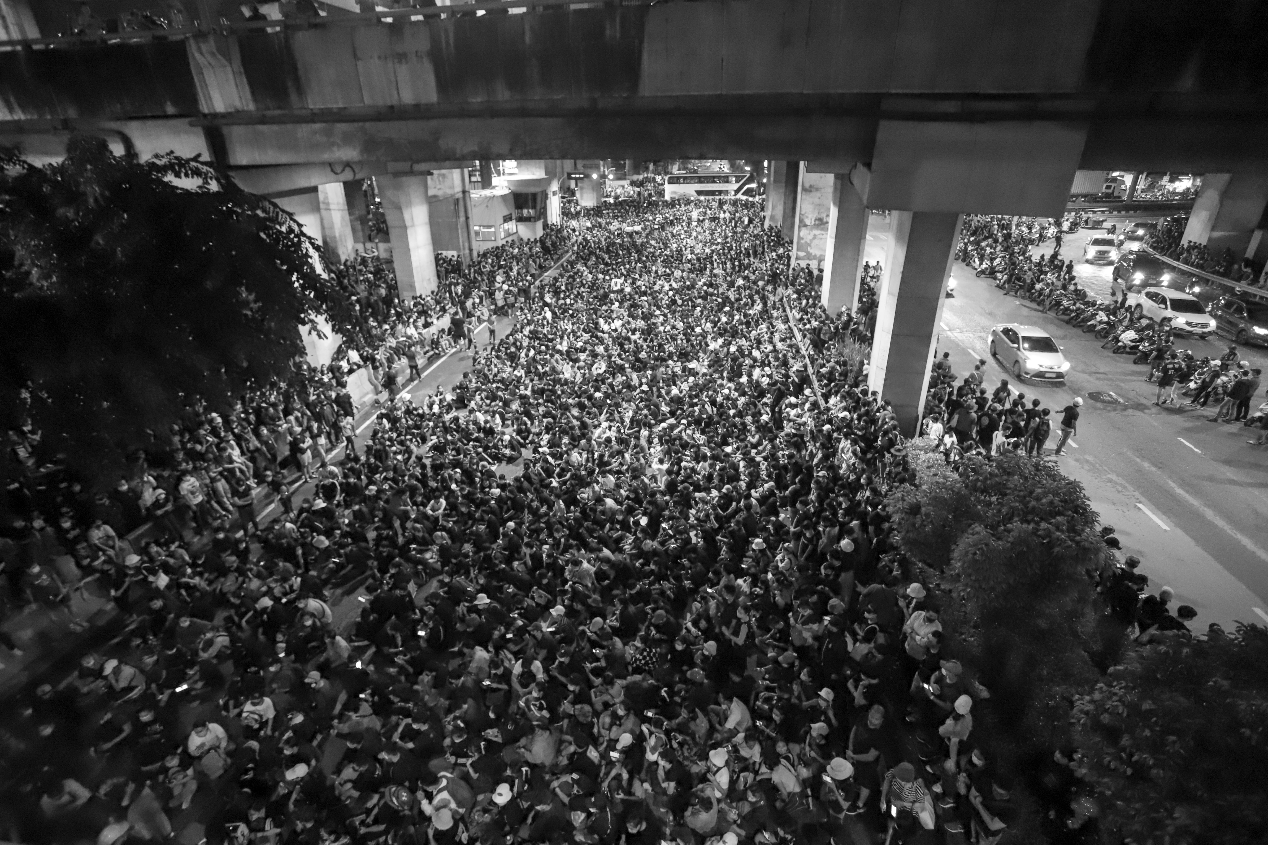
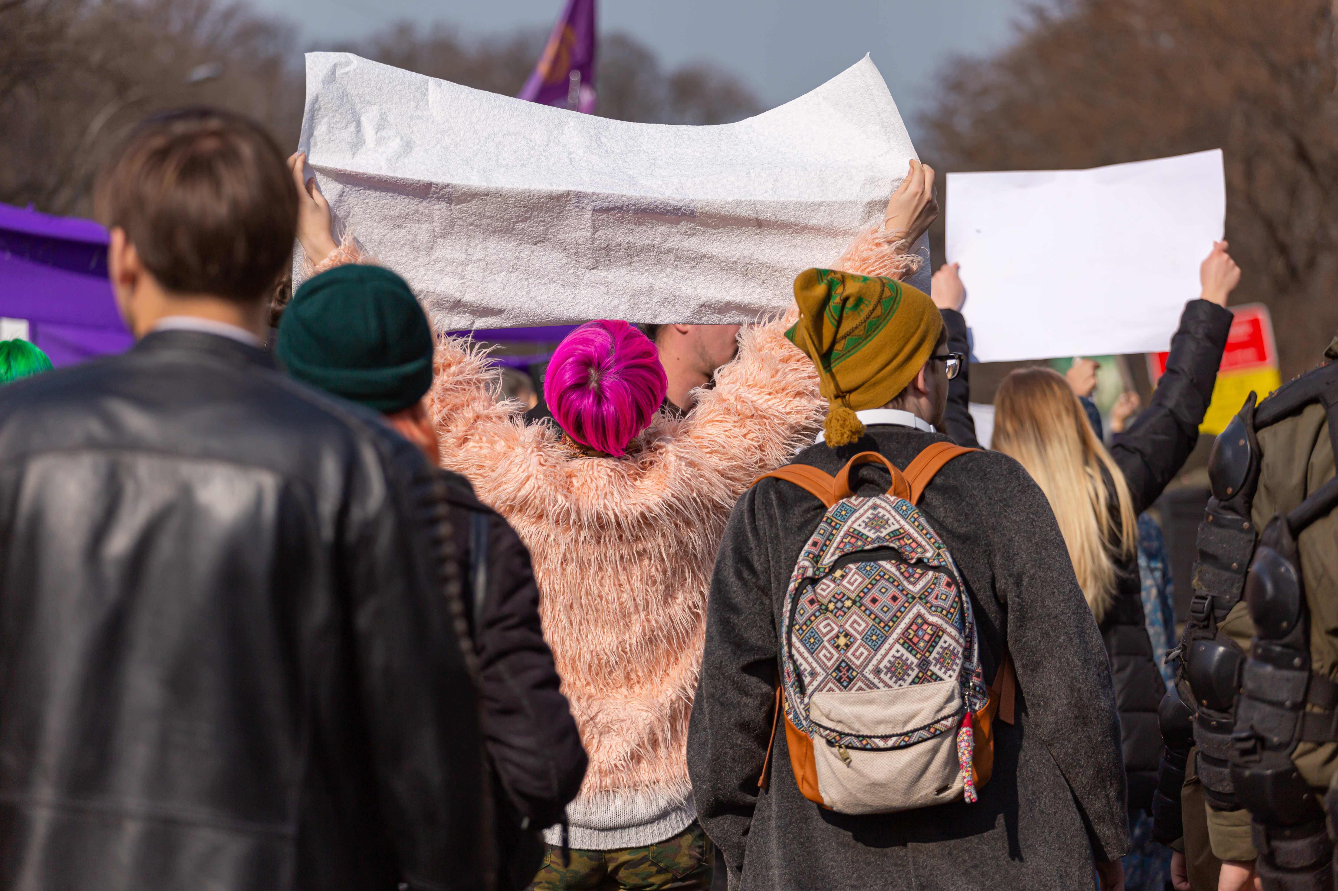
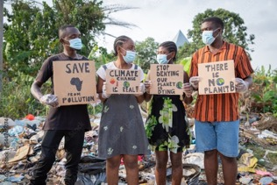
Resilience Revolution
Don't worry! It's not all doom and gloom.
Adolescent peer influence is a positive thing when it pulls people together.
Young people have a history of rebellion and revolution for change.
Youth movements depend on strong friendships helped by the amygdala wanting them to fit in.
To manage stress, young people could join with their friends, put their prefrontal cortices together and build resilience in each other.
Powerful youth revolutions depend on social bonds.
What else?
Notes:
But it's not all doom and gloom. Adolescents are really influenced by their peers - but wait, didn’t we just say that peer influence was a bad thing? Well, that depends, peers pressuring each other to drive a car too fast, take drugs or stop each other from wearing new trainers because they are the wrong brand is not great. But what is great is when that social influence pulls people together. Remember young people have a history of rebellion and revolution to push for change. Youth movements depend on strong friendships that exist because of the amygdala that tells them to do things for their friends. To manage stress young people could put their prefrontal cortices together and decide with their friends to build resilience in each other. This could help as they grow into adults, in charge of this uncertain and chaotic world. These social bonds can help them to build resilient minds, creative brains that can adapt to solve stressful problems, are not paralyzed by the fear of making a mistake, and have strong supportive social networks.

Slide 17

Case Studies
What are the characters finding difficult or challenging?
What growth mindset strategies are they using to deal with this?
Read through Amber and Kai's case studies in your Lesson 3 Worksheet.
Notes:
Let’s think about these two case studies and how Kai and Amber could use the idea of the stress bucket to turn on some de-stressing taps. Let’s also think about how they could use their social networks to help them.

Slide 18
Case Studies
What strategies are Joe and Tia currently using, and what might the problems be with these?
What can Joe and Tia learn from Kai and Amber?
Now read through Joe and Tia's case studies in your Lesson 3 Worksheet.

Slide 19
Read through the scenario about Joe and rollerblading, at the top of the 'individual' chart in your worksheet.
How did Joe feel before he started?
How did he feel afterwards?
Did anything he was worried about actually happen?
Could this activity be a good stress bucket tap for Joe in the future and why?
Individual
Date/Time | Action | How did you feel before you started | How did you feel afterwards | Did anything that you were worried about beforehand actually happen | Do you think this could be a good stress bucket tap in the future?
Wed, 8am | Go to a roller disco with my cousin | Scared and worried that someone would see and think it was a stupid idea | Brilliant! I loved it, apart from when I fell on my bum! | I did see someone from school, but they seemed to be having fun and waved at me. It didn’t look like they thought it was a stupid thing to do! | Yes, and I think if I invited a few, new friends to come next time we could enjoy it together and it would help me get to know them better.

Slide 20
Read through the scenario about Amber and Tasha, at the top of the 'social' chart in your worksheet.
What was Tasha’s friend Amber stressed about?
What did Tasha do to help?
How did Amber feel afterwards?
How did Tasha feel afterwards?
Social
Date/Time | What was your friend stressed about? | What did you do to help? | How did they feel afterwards? | How did you feel afterwardS? | How did it go / what happened next?
Wed, lunchtime | My friend Amber really wants to audition for the school production but is worried about messing up and being judged. | We went to the music rooms at school, and she practiced her audition in front of me. | She felt pleased she did it and more confident for the actual audition. | I felt good that I had supported her and helped her feel more confident. | She was nervous to begin with, and we kept laughing. But then she did it properly and it was really good. She’s signed up for the auditions so hopefully she’s going to go for it!

Slide 21
Last time we thought about how to use growth mindset when we notice we are worried or stressed. This week we will set ourselves two challenges. Turn to your worksheet. This exercise is just for your reflection, you will not need to share your responses.
Individual: overpower your amygdala! Add a tap to your stress bucket that can help you to manage feelings of stress.
Social: Support a friend's prefrontal cortex. Uplift a friend and help them build up their resilience.
Personal reflection
A challenge
Date/Time | Action | How did you feel before you started | How did you feel afterwards | Did anything that you were worried about beforehand actually happen | Do you think this could be a good stress bucket tap in the future?
Notes:
Finally, let’s challenge ourselves. In our activity last time we thought about how to use growth mindset when we notice we are worried or stressed. This time we are going to put into practice what we have learned during these lessons. Turn to your worksheets and think about the individual and social strategies you could try to overcome your amygdala’s stress response or help a friend to build up their own stress resilience.

Slide 22


In summary
Young people understanding their own brain development can support their own and each other’s mental well-being.
This will help them grow into adults with resilient minds and creative brains to solve stressful problems, who are unafraid of making mistakes, and have strong supportive social networks.
Your 'neuro-story' can be written and re-written by you and with the help of your friends

Slide 23
End point reflection–Lesson 3 Endpoint Student Questionnaire
Complete the "Lesson 3 Endpoint: Student Questionnaire" on your Lesson 3 worksheet. You will not be asked to share your answers.

Slide 24
Support available
If you found anything we discussed today distressing, you have multiple options for support.
[INSERT SCHOOL-SPECIFIC INFO HERE]
Or contact/access online resources via:
Childline (0800 111 https://www.childline.org.uk/)
Young Minds (https://youngminds.org.uk/)
Samaritans (116 123)

Slide 25

These lessons have been developed by a team from the University of Oxford (Departments of Clinical Neuroscience, Experimental Psychology, and Psychiatry), with involvement from teachers and young people. This project was funded in part by the University of Oxford Enriching Engagement scheme, funded by Wellcome.

