Slide 1

The first slides in this deck are for teacher reference. The student-facing slides begin after the orange divider slide.

Slide 2
The following slides are optional extras with more in depth science information – you can insert these where indicated, if appropriate for the knowledge/interest levels of your students. The "notes" function at the bottom of each slide provides more detailed talking points.

Slide 3

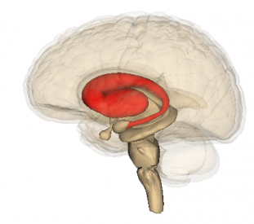
Phase 1: what’s happening in the brain during learning?
Getting a reward causes dopamine, a chemical messenger, to be released into a region of the brain called the striatum.
Striatum
Dopamine made here
[This and the next two slides could replace slide 16 if desired]
Notes:
Let’s zoom in on phase 1: learning. Knowing what leads to good outcomes or bad outcomes is really important for human survival and so our next question is how does the brain do this? To study this scientists measured changes in brain chemicals while humans and other animals learned from succusses and mistakes. They showed that when people get a reward unexpectedly a chemical called dopamine is released into a region of the brain called the striatum. When people unexpectedly make a mistake, the amount of dopamine in the striatum drops. Dopamine is a chemical that gives people that good, happy feeling. The striatum loves dopamine, and this means that people are likely to want to do whatever it is that just gave them the reward again.

Slide 4
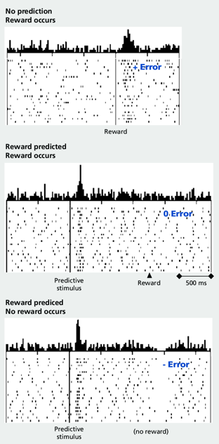


1. There is always some dopamine in the brain.
2. But dopamine is released more to unexpected reward
3. Dopamine is released when something predicts reward
4. But dopamine does not change if reward is expected
5. And there is less dopamine when a reward does not come.
Notes:
Here is an example. Imagine someone visits their Grandma and she unexpectedly gives them a pound. This outcome increases dopamine in their brain and tells them something good happened. So they start visiting their Grandma every day and every day she gives them a pound. These plots show the amount of dopamine (a black tick) that would be released in their brain each day they visited their Grandma (days are a row in the plot). If we add up the dopamine across the days they visit Grandma we get the black bars at the top of the graph. [1 & 2] This shows that there is lots more dopamine when Grandma gives them the money (at the “reward”). [3 & 4] Over time dopamine shows a different pattern and starts to be released when Grandma opens the door and they begin to expect they are going to get a pound, but it is not changing at the time when she actually gives them the money. This shows us that dopamine is a learning signal: it helps people learn by telling them when rewards or errors are unexpected. And if there is nothing to learn the levels of the chemical in the brain don’t change. [5] Finally, if Grandma starts to forget to give them a pound they get a decrease of dopamine at the time they expected to get the money.

Slide 5
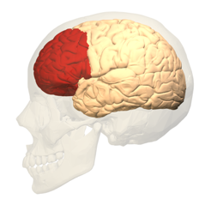
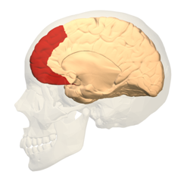


Prefrontal cortex
These reward and error dopamine signals are sent from the striatum to the prefrontal cortex
They help the prefrontal cortex learn about the different behaviours that could let people reach their goals. This is how the prefrontal cortex supports flexible behaviour.
People with damage to this area struggle with everyday planning, learning and decision making.
Striatum
PFC damage would mean that people would keep visiting Grandma long after she stopped giving them a pound.
But of course, people should always visit their Grandmas, with or without pounds.
Notes:
But that’s not the end of the story. The dopamine messages are then sent from the striatum to the prefrontal cortex. The prefrontal cortex is the area of the brain that has grown most from monkeys to humans. Here these signals help the prefrontal cortex learn about the different behaviours that could help people reach their goals – even the ones that lead to mistakes. Over time then the prefrontal cortex is able to build up a toolbox of strategies it could try in the future and in this way the prefrontal cortex is supporting flexible behaviour. Basically, the prefrontal cortex is saying “If this doesn’t work, try this, or if that doesn’t work, try this instead”
Some people, through accident or illness, have damage to their prefrontal cortex. These individuals can struggle with everyday behaviour like planning, learning and making decisions. People with prefrontal damage struggle to change their behaviour when things change around them. For example, prefrontal damage would mean people would keep visiting their Grandma even though she had stopped giving them a pound.

Slide 6
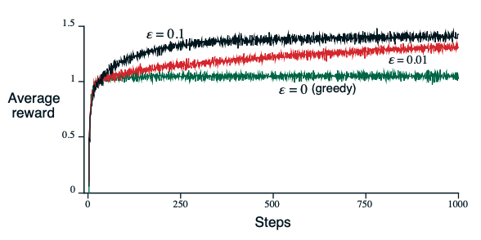
Why making mistakes is important
Did you know that computers have to make mistakes to learn in the best way and get the most reward?
It is important to try things out when learning
Practice makes progress
But it's important to stay flexible too...
This is because:
The best choices aren’t always clear.
The best choices can change over time.
The best choice for now might not always be the best.
Game plays
A computer always chooses what it ‘thinks’ is best. It doesn’t explore potentially better options (black line).
A computer sometimes (1% and 10%) chooses randomly. It explores its options and knows its environment better.
[This slide could replace slide 23 if desired]
Notes:
But why do people need flexible behaviour? Well, if people weren’t flexible they would end up stuck trying the same strategy again and again without reaching their goal. What a waste of time and energy. Everyone's brains use mistakes to tell them that they need to try something different to succeed. This is really important when people are growing up, because in different environments any one of these different strategies might be the difference between winning and losing. And if people have been able to practice them through trial and error then their brains and bodies are primed to be flexible, and it gives them the best chance of winning. But it’s worth trying out different options while learning, because the best choices aren’t always clear, the best choices can change over time, and the best choice for now might not always be the best. Amazingly, the world’s smartest computers are programmed to make a certain percentage of mistakes. These super "intelligent" computers are only able to find the best options by being told to explore their artificial environment. The plot shows how much average reward (y axis) the computer finds when it is told to make 1% (red line) or 10% (black line) random choices, compared to when the computer always chooses what it “thinks” is the best option (green line). Sometimes by trying something new the computer will make a mistake, but sometimes that novel choice will pay off and show them that there was a better choice than the one they had settled on.

Slide 7
Student-facing slides begin with next slide

Slide 8

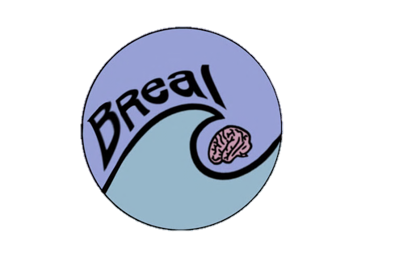
Building stress resilience in early adolescents’ lives

Slide 9
LESSON 2
Baseline –
Continuum Activity
Turn to the "Continuum Activity" on your Lesson 2 worksheet and complete this independently. You will not be asked to share your answers.

Slide 10
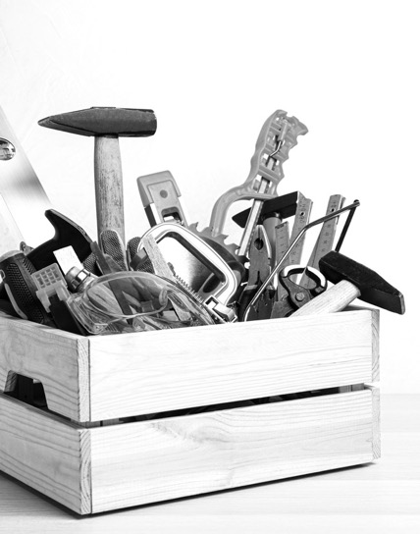
Building a stress toolbox
This multi-lesson course is on STRESS
and how to deal with it.
Throughout these lessons we will …
Explore: what stress is and how people respond to it
Discover: stress isn’t always bad!
Challenge: ourselves to respond well to it
Learn: new ways to respond to stress
Practice: being brave
Notes:
Welcome to the second lesson of the BReal course. These resources were put together by a group of neuroscientists, clinical psychologists, public engagement specialists and teachers. BReal aims to engage young teenagers and equip them with the knowledge and practical skills to drive their own brain development in a positive direction that promotes good mental health. The project aims to inform, inspire and empower teenagers to cultivate stress resilience skills and thus enable them to better manage their own minds.

Slide 11
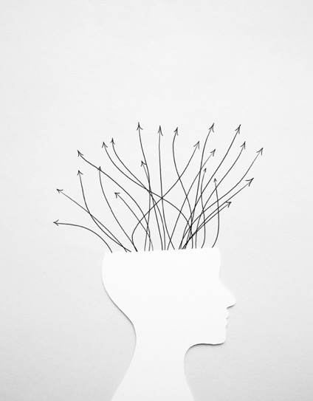
Learning from mistakes
Fear of making mistakes can stress people out and stop them from solving problems. But to learn, making mistakes is essential! – this is how brains adapt to do better next time. The objective of this lesson is to learn that making mistakes and practising dealing with stress helps to manage stress. Today we will:
Explain what happens in the brain during reward or error.
Describe the importance of learning from mistakes, especially during adolescence.
Assess the different impact of responding to stress with different mindsets.

Slide 12
Ground Rules
It is important that ground rules are in place to create a safe learning environment that enables everyone to learn effectively. Let's establish ground rules as a class.
For example:
Everyone has the right to be heard and respected
We won’t share our own personal experiences
We have the right to pass
What else?

Slide 13

Learning from mistakes
No one likes making mistakes … BUT the brain uses mistakes to help people change their behaviour, to try out something different, AND in this way to find better solutions for the future. So, mistakes are really important.
https://vimeo.com/874360134

Slide 14
Group work
In groups, using what you learned in the video, write what you know about....
How brains learn from successes and mistakes
What else?

Slide 15



Phase 1: Learning a new skill
When people learn anything new, like surfing, they will fall off their surfboard as often as they stay on.
These experiences of success and mistakes act as rewards and errors that help them change their behaviour over time.
How could they stand next time?
Phase 2: Practising a skill
Once people have figured out the basic successful strategy it’s now time to go from beginner to advanced level. They can do this by practising!
Over time they will:
- Make fewer mistakes.
- Get faster and more efficient.
How do people learn
from successes
and mistakes?
Notes:
As we can see making mistakes is a key part of learning and over the last 100 years, we have learned a lot about how we learn (which we are calling phase 1 here) and we have learned a lot about why practicing is so important (phase 2). Firstly, we now know that as people learn they begin to associate outcomes with the actions and choices they make that lead to those outcomes. When trying to learn something new, people first must explore and experiment, and try out different things. In this way they discover that some things they try work well, while others don't. Both are equally important for learning. For example, when people begin to learn a new skill, like surfing, where and how they stand on the board matters. If they stand too far forward they are likely to fall off. If they stand towards the back of the board the outcome is likely to be better and they'll stay on. These experiences of success and mistakes act as rewards and errors that help them change their behaviour over time. Once they have the basic strategy, they can fine tune their skills through practice. Over time they will make fewer mistakes and get faster and more efficient.

Slide 16


Phase 1: What happens in the brain when people learn?
Dopamine made here
When someone gets something right unexpectedly a chemical called dopamine is released into a region of their brain called the striatum.
When people unexpectedly make a mistake, the amount of dopamine in the striatum drops.
Dopamine messages are sent from the striatum to the prefrontal cortex.
Striatum
What else?
Notes:
Let’s zoom in on phase 1: learning. Knowing what leads to good outcomes or bad outcomes is really important for everyone's survival and so the next question is how does the brain do this? To study this scientists measured changes in brain chemicals while humans and other animals learned from succusses and mistakes. They showed that when people get a reward unexpectedly a chemical called dopamine is released into a region of the brain called the striatum. When people unexpectedly make a mistake, the amount of dopamine in the striatum drops. Dopamine is a chemical that gives people that good, happy feeling. The striatum loves dopamine, and this means that they are likely to want to do whatever it is that just gave them the reward again. But interestingly over time, if they keep getting it right – the chemical stops being released. This means that dopamine is a learning signal: it helps people learn by telling them when rewards or errors are unexpected. And if there is nothing to learn the levels of the chemical in their brain don’t change. But that’s not the end of the story. The dopamine messages are then sent from the striatum to the prefrontal cortex.

Slide 17


These messages from the striatum help the prefrontal cortex learn which behaviours could help a person reach their goal – this means that learning from the mistakes is just as important as learning from the successes.
The prefrontal cortex supports flexible behaviour by building a toolbox of strategies that can be tried out in future.
Dopamine made here
Striatum
Prefrontal cortex
What else?
Notes:
The prefrontal cortex is the area of the brain that has grown most from monkeys to humans. Here the signals from the striatum help the prefrontal cortex learn about the different behaviours that could help someone reach their goal – even the ones that lead to mistakes. Over time the prefrontal cortex is able to build up a toolbox of strategies the person could try in the future and in this way the prefrontal cortex is supporting flexible behaviour. Basically, the prefrontal cortex is saying “If this doesn’t work, try this, or if that doesn’t work, try this instead”

Slide 18
Phase 2: What happens in the brain when people practise?
Prefrontal cortex
Striatum
Learning helps people find a good strategy, but next they need to practise those behaviours to become more skilled.
This doesn't just apply to surfing, but to learning anything new – in schoolwork, hobbies, facing fears, or coping with stress.
When people practise, they strengthen the connections between brain areas that control those behaviours, so that messages can be sent faster and clearer.
Practice changes people's behaviour and their brains: this is called plasticity.
Notes:
Learning helps us find a good strategy, but in the next phase people need to practise those behaviours to become more skilled. And obviously this doesn’t just apply to surfing, but to anything new someone is learning – schoolwork, hobbies, facing fears, coping with stress. As people practice they are strengthening the connections between the striatum and the prefrontal cortex, as well as other areas involved in that specific behaviour, which in surfing would be the areas of the brain that control the muscles in the arms and legs. With practice these connections physically change, by either growing more connections or making those connections faster and more efficient. This means that the messages that are sent back and forth between those regions can be faster and clearer. It’s like the brain is turning up the bandwidth by improving the internet cables. These changes in behaviour and brains are called plasticity.

Slide 19
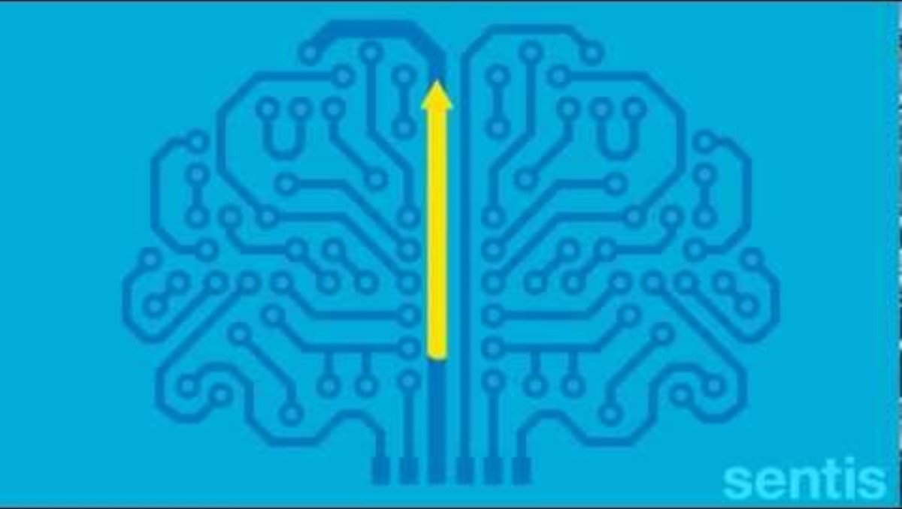
Plasticity video
Watch this video to learn more about plasticity:
https://www.youtube.com/watch?v=ELpfYCZa87g

Slide 20
Group work
In groups, using what you learned in the video, write what you know about....
The importance of practising and making mistakes
What else?

Slide 21
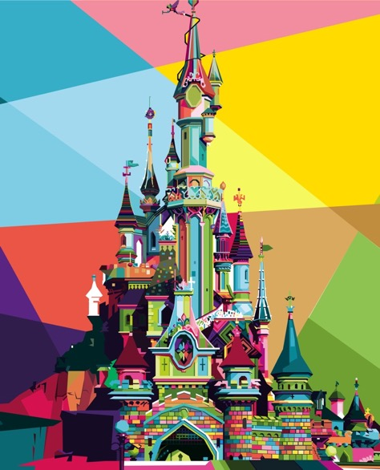
Everyone makes mistakes
Even though everyone makes mistakes at times, strangely, few people are brave enough to talk about the mistakes they made on their path to success.
Look at Walt Disney, who is now remembered for his animated movies and theme parks (e.g. Disneyland, Disney World) that are now worth billions of pounds.

Slide 22
Everyone makes mistakes
Walt Disney was fired as a journalist for lacking imagination and having no good ideas.
His first animation company failed because of a bad decision to let other businesses take 6 months to pay for his cartoons.
Walt Disney struggled to pay his rent and (reportedly) had to survive by eating dog food.
But – learning from his mistakes, he would go on to be nominated for 59 Oscars and become known as one of the greatest animators of our time.

Slide 23
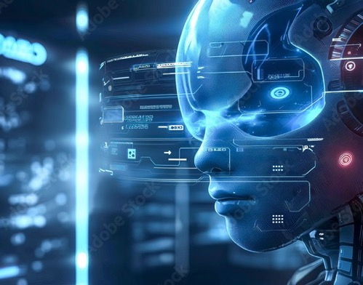
Why making mistakes is important
It is important to try things out when learning
Practice makes progress.
But it's important to stay flexible too...
This is because:
The best choices aren’t always clear.
The best choices can change over time.
The best choice for now might not always be the best.
Did you know?
Even super "intelligent" computers are programmed to make mistakes and learn from them!
Notes:
But why do people need flexible behaviour? Well, if they weren’t flexible they would end up stuck trying the same strategy again and again without reaching their goal. What a waste of time and energy. People's brains use mistakes to tell them that they need to try something different to succeed. This is really important when they are growing up, because in different environments any one of these different strategies might be the difference between winning and losing. And if they've been able to practice them through trial and error then their brains and bodies are primed to be flexible, and it gives them the best chance of winning. But it’s worth trying out different options while learning, because the best choices aren’t always clear, the best choices can change over time and the best choice for now might not always be the best. Amazingly, the world’s smartest computers are programmed to make a certain percentage of mistakes. These super "intelligent" computers are only able to find the best options by being told to explore their artificial environment. Sometimes by trying something new the computer will make a mistake, but sometimes that novel choice will pay off and be better than they expected.

Slide 24

Adolescence:
A really important time for the brain
Adolescence is a special time for the prefrontal cortex. During this time it is developing rapidly as young people learn.
This brain region stays very plastic across adolescence until people are in their 20s.
This means NOW is the best time to make mistakes and learn from them – practice makes progress, a more plastic brain and a stress resilient self!
Notes:
So, why should people care about all this? Making a mistake feels embarrassing and stressful. Surely primary school is the time to make all the mistakes. I’m sure everyone made a lot of mistakes in primary school that usually involved falling over or falling off things. Young people are much less likely to fall over – surely that means they're done making mistakes. Well not quite. All that learning and brain plasticity that happened to stop them falling over, or helped them learn to read and so on, happened in the parts of the brain behind their prefrontal cortex. During adolescence it’s their prefrontal cortex’s turn to develop, mature and specialise. This area of the brain stays plastic across adolescence and in fact won’t be fully developed until the mid 20s. This means that it really is the best time of life to make mistakes so young people can learn from them and train their brains.

Slide 25

Adolescence is a great time to practice
Practice getting out of the comfort zone and (if safe!) making mistakes.
This will strengthen the prefrontal cortex, striatum and their connections.
It helps people to:
learn well and stay flexible.
build up a toolbox of different strategies to solve difficult and stressful problems.
Flexibility is important because the world is always changing and new problems appear, so being flexible means people can cope better with whatever the future brings.
Striatum
What else?
Notes:
As people learn they build up connections between different areas in their brain, and their striatum and prefrontal cortex are then better able to talk to each other and work more efficiently to tackle problems as a team. Like footballers, the more they practice the better they work as a team to move the ball between them without kicking it off the pitch. Over time, with practice, people get better and better at everything from surfing, to reading, writing, maths, to singing. Practice, and importantly, making mistakes, makes for a rich, connected brain network to use the next time they have to take on a challenge.
Being able to learn well and stay flexible will help people adapt when difficult and stressful problems arise and need to be solved by trying different strategies. Practice and thinking of how to solve a problem from different angles (the job of the prefrontal cortex) will help them develop that stress busting toolbox.

Slide 26
The right attitude
Everyone can help their prefrontal cortex build its toolbox by thinking about mistakes from a new perspective.
Learning well from mistakes takes the right attitude.
Something called Growth Mindset can help with this.
Notes:
Everyone can help their prefrontal cortex build its toolbox by thinking about mistakes from a new perspective. But learning well from mistakes takes the right attitude. Psychologists call this approach Growth Mindset, but it is also known by a variety of other terms.

Slide 27
Mindset to support learning
VS
Learning well from mistakes takes the right attitude.
Growth mindset says…
‘mistakes are nothing to be ashamed of’
‘mistakes help me learn’
‘If I practice and put in the effort, I can succeed’. ​
Fixed mindset says…
‘I’m a loser’
‘I’m rubbish’​
‘I’ll never be any good’
‘If I keep trying, I’ll just keep failing’
Notes:
Growth mindset is the opposite of Fixed Mindset. A fixed mindset says 'if I do something badly I’m a loser’, ‘I’m rubbish’, ‘I’ll never be any good’, ‘if I keep trying, I’ll just keep failing’. But a growth mindset says, ‘mistakes are nothing to be ashamed of’, ‘mistakes help me learn’ and ‘if I practice and put in the effort, I can succeed’.
Changing behaviour can change feelings about it because this is changing the connections in the brain.
Findings from science labs and clinical experience suggest that learning from mistakes is as important as learning from successes and that the most helpful way to learn is by approaching challenges with a growth mindset: mistakes are normal, they help people learn, keep them flexible, and able to tackle new things in different ways in future. Mistakes are – literally – opportunities for brain growth.

Slide 28
Case Studies
Describe the strategies they are using
Identify whether they are responding with a fixed or growth mindset
Explain possible outcomes
See your Lesson 2 Worksheet for case studies Maryam and Harry.
Discussion questions:

Slide 29
In the last lesson, we practised noticing our worries and our own body's response to stress.
Now that we know a mistake is as useful to our brain for learning as a success, we know we do not need to fear getting it wrong.
This time we will think about how changing our behaviour could change how we feel.
This exercise is just for your reflection, you will not need to share your responses.
Personal reflection
Practice Makes Progress:
Growth mindset
Date/ Time | What were you stressed about? | How did you feel? | What did you want to do? | How could you respond to this event with a growth mindset? | What impact would it have to try this growth mindset strategy instead?
Wed, 8am | Realised I hadn’t done my homework that was due in that day | Scared and cross | Stay home from school, tell my teacher that it must have fallen out of my bag, rush through it before school. | I could speak to my teacher and apologise. I could explain what happened and ask for an extension so I could do it properly. | My teacher would probably say I could have an extra day to finish the work and ask if I need help with learning better time management.
Notes:
Psychologists have shown that people can change how they feel by changing and challenging their behaviour to experience the thing they are scared of. When they experience the thing they are scared of and they see that it is not (usually) as bad as they expected, they learn from that experience. You can see how that makes sense with what is happening in the brain. When people try something, and it is not as bad as they thought it was going to be, the dopamine in their striatum tells their prefrontal cortex to remember the better-than-expected-experience for next time. So a mistake is as useful to the brain for learning as a success, and that what can go wrong is usually not as bad expected, there is no need to fear getting it wrong.
In this exercise, in addition to noticing what it was that made us feel stressed and how it made us feel, we want to think of new ways to think about or act on the problem. Use that prefrontal cortex of yours to think around the problem. You might have tried one way last time you forgot your homework, you might have tried the avoidance strategy. You might have tried to pretend you were ill and stayed at home! What if you tried something else? Like honestly explaining to your teacher what happened, apologising, and proposing a new realistic deadline. Your teacher is likely to appreciate your mature approach to the problem and ask if you need help to support your time management.

Slide 30

In summary
Learning to learn well from mistakes feels hard –that’s completely normal!
Just remember with each mistake someone makes, they strengthen their brain and learn to be adaptive.
So, try to be brave!
Your 'neuro-story' will contain mistakes; use them to let your character grow

Slide 31
End point reflection–Revisit Continuum Activity
Return to the "Continuum Activity" on your Lesson 2 worksheet and fill in answers again with a different colour of pen or different symbol. You will not be asked to share your answers.

Slide 32
To be continued …
By the next session you will be trying out different strategies to deal with common problems – facing fears and learning from what happens.
In the next session we’ll talk about dealing with the wobbles. We’ll look at the research that tells people how they can support their own brain and each other’s in managing stress.

Slide 33
Support available
If you found anything we discussed today distressing, you have multiple options for support.
[INSERT SCHOOL-SPECIFIC INFO HERE]
Or contact/access online resources via:
Childline (0800 111 https://www.childline.org.uk/)
Young Minds (https://youngminds.org.uk/)
Samaritans (116 123)

Slide 34

These lessons have been developed by a team from the University of Oxford (Departments of Clinical Neuroscience, Experimental Psychology, and Psychiatry), with involvement from teachers and young people. This project was funded in part by the University of Oxford Enriching Engagement scheme, funded by Wellcome.

