Slide 1

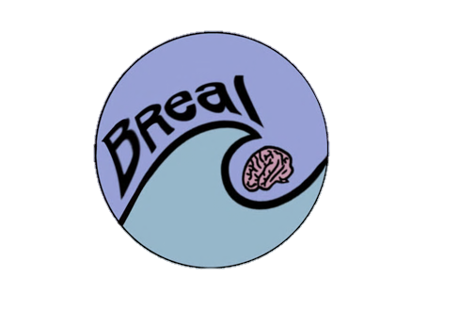
Building stress resilience in early adolescents’ lives
Notes:
Welcome to the first lesson of the BReal course. These resources were put together by a group of neuroscientists, clinical psychologists, public engagement specialists and teachers. BReal aims to engage young teenagers and equip them with the knowledge and practical skills to drive their own brain development in a positive direction that promotes good mental health. The project aims to inform, inspire and empower teenagers to cultivate stress resilience skills and thus enable them to better manage their own minds.

Slide 2

LESSON 1
Baseline –
Student Questionnaire
Turn to the "Student Questionnaire" on your Lesson 1 worksheet and complete this independently. You will not be asked to share your answers.

Slide 3

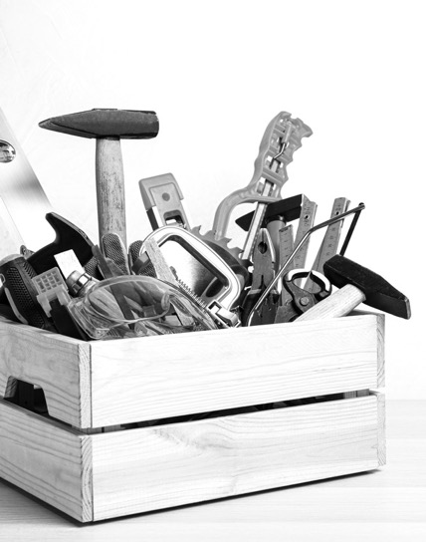
Building a stress toolbox
This multi-lesson course is on STRESS
and how to deal with it.
Throughout these lessons we will …
Explore: what stress is and how people respond to it
Discover: stress isn’t always bad!
Challenge: ourselves to respond well to it
Learn: new ways to respond to stress
Practice: being brave

Slide 4
Ground Rules
It is important that ground rules are in place to create a safe learning environment that enables everyone to learn effectively. Let's establish ground rules as a class.
For example:
Everyone has the right to be heard and respected
We won’t share our own personal experiences
We have the right to pass
What else?

Slide 5

Exploring stress and how people respond
People can learn when to use strategies that deal with stress by first noticing their worries and their own body's response to those worries.
Today we'll learn an exercise to help do this.
Notes:
Clinical psychologists have shown that people noticing their worries and their own body's response to stress can help them know when to use strategies to deal with those stressors. By the end of the session today you will have tried an exercise to help do this.

Slide 6
Born to be brave
In life people will face scary, difficult things. But did you know…?
Humans were born to be… BRAVE!
The objective of this lesson is to learn about the stress response and ways of managing stress. Today we will learn how to:
Explain how the mind and body respond to stress.
Identify how stress affects different people in different ways.
Assess healthier ways to respond to stress, including challenging ourselves.

Slide 7
What is stress?
“Stress is the feeling of being overwhelmed or unable to cope with mental or emotional pressures.”
Mental Health Foundation
The word stress comes from the historical meaning, "the use of pressure".
But…
Notes:
The Mental Health Foundation defines stress as “the feeling of being overwhelmed and unable to cope with mental or emotional pressures”. This is a standard, popular understanding of what stress is. But is it the whole story? It seems to imply that if someone is stressed it might even be their fault, because they are feeling overwhelmed and unable to cope. Scientists have a different definition of stress, the original definition in fact. That definition focuses on the person or the animal as a whole and the goals of the person/animal – to stay alive.
Fun fact – the word stress comes from the Indo-European root ‘str’ which historically means exertion of pressure. Words like "strangle" have similar roots.

Slide 8

What is stress?
The scientific definition of stress is more specific.
All animals try to keep their bodies' functions balanced. This is called homeostasis.
Anything that threatens that balance is a stressor.
Stressor:
hunger
Change
behaviour
Homeostasis
Notes:
All living things are always trying to keep their bodies in a balanced state. Everything - heart rate, the amount of glucose in the blood, oxygen rates, etc. - all of these things interact with each other and must be kept in balance (i.e. homeostasis). Anything that threatens that balance is a stressor. If someone is hungry it can be because there is not enough glucose in their blood to keep their cells working. They are out of balance. Hunger is a stressor and the body’s response to solving this stressor is to engage in behaviours in the environment to restore internal balance by eating food. So the function of stress is to signal to the person that there might be something wrong in their body or their environment and that they need to change their behaviour to sort it out. Thinking about stress in this way is more helpful. With this scientific definition, stress is not someone being unable to cope, it is instead about something in their body/environment putting pressure on them.

Slide 9

Training the brain to cope with stress
Stress can feel bad....
BUT learning to respond well can help people feel better
AND train their brains to cope better with stress in future.
https://vimeo.com/874358621
Notes:
Even though we can see that the stress response is just the body's way of changing people's behaviour to get back to a normal state, when people get stressed, it feels bad. This makes sense as the body is forcing people to do something to feel better – to get back in balance. For example, not to be hungry anymore, or not to get eaten by the tiger. Knowing this, people could learn to respond well to stress and train their brain to deal with stress when they experience it in the future. Findings from science labs and clinical experience suggest that the most helpful way to learn something new is to be brave: to get stuck in, learn from the experience of doing, and learn from getting things wrong. Let’s watch this video which explains the ideas behind this.

Slide 10

Group work
In groups, using what you learned in the video, write what you know about....
What stress is
How minds and bodies can respond to it
Different effects it can have
What else?

Slide 11
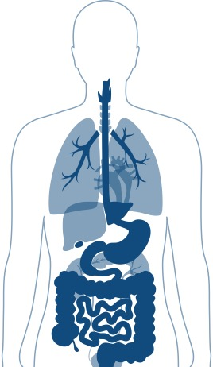
Brain gets active, releases chemicals (neurotransmitters)
The science of stress
Lungs breathe faster
Faster heart rate
Stress affects the whole body…
let’s find out how!
Liver works harder
Kidneys release stress & action hormones
Stomach slows down
Higher blood pressure
Notes:
The body responds in a similar way regardless of whether the stressor is something that someone is dealing with right now (e.g. fighting the tiger after it runs at them) or something the person expects to deal with in future (e.g. thinking they might meet a tiger in the jungle). Here we can see how the whole body adapts to the danger and we can think about why that might be a helpful response to keep people alive in that situation. e.g. brain gets active and releases chemicals to increase alertness and brain power to think quickly, kidneys release stress and action hormones to prepare the body for action, lungs breathe faster to get more oxygen to the body for fight or flight response, faster heart rate to get glucose and oxygen to the muscles, higher blood pressure to force the blood around the body faster, stomach slows down as there is no time to process food now, liver works faster to deal with the cells' output. The body is primed for action.

Slide 12
A stress sweet-spot
Performance
The Yerkes-Dodson effect shows that people need just the right amount of stress to perform at their best.
Not too much or too little.
Arousal (stress)
Notes:
And it’s not that we think all stress is bad. There is a scientific law called the Yerkes-Dodson effect that shows how people's performance on tasks that test their memory, attention and decision-making abilities are affected by stress. You can see a bit of stress is good, but too little or too much means they are either too chilled out to do well or so stressed out they cannot perform at their best. The sweet spot is in the middle.
Fun fact – homeostasis is an important idea that was already being discussed by ancient Greek philosophers, who called it harmony.

Slide 13
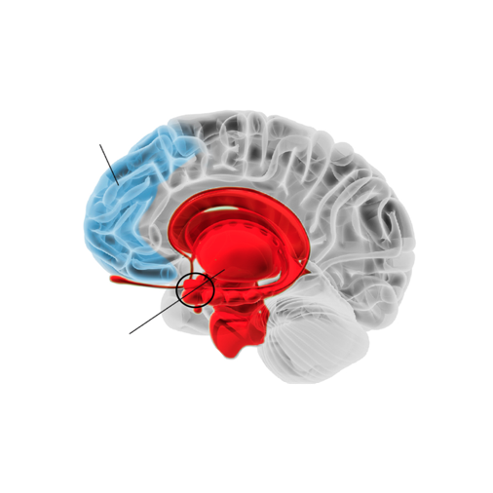
The prefrontal cortex helps to calm the limbic system and control stress
The science of stress
Prefrontal
cortex
Let’s zoom in on the brain …
Amygdala
Limbic system
The limbic system (especially the amygdala) signals the alarm when the person feels stressed
Notes:
Let’s zoom in on the brain and two key players in the stress response. Firstly, the stress system turns on the amygdala, a brain region that is part of a set of regions called the Limbic system. The amygdala creates the fear response (that can lead to a change in behaviour that reduces stress), but it also re-stimulates the stress system. So the amygdala can create what's called a feedback loop that further increases the stress response. By contrast, the prefrontal cortex tries to inhibit the stress response, as it tries to calm the limbic system down. The push-pull relationship between these two brain regions is one way the body tries to get back to a balanced state.
Anatomy extension: The amygdala (or amygdala nuclei, as there are two of them, one each side of the brain) are the shape of an almonds and are tucked deep into the brain. Scientists have discovered they are involved in emotional responses, including the stress and fear response, making memories and decision making. In comparison, the prefrontal cortex is a large area of the brain, positioned right at the front. It can itself be broken down into lots of smaller regions. All these regions perform complex functions in the brain like short term memory, paying attention, learning and decision making. The prefrontal cortex is connected to all the brain regions further back in the brain. Scientists think the prefrontal cortex takes all the information from the rest of the brain to help someone decides how they are going to act on that information, but also feeds back information to the earlier brain regions to control their activity.

Slide 14

Adolescence:
a critical time of brain development
Adolescence is a very important time for learning to control stress.
Why? During adolescence connections are strengthening between the prefrontal cortex and the amygdala, which control response to stress.
How to make those connections healthy and strong? Practice stress coping skills!
What else?
Notes:
As we saw in the video, adolescence is an important time in learning to control the stress response. That is because, contrary to what scientists used to think, the brain does not stop developing after childhood. In adolescence, it doesn’t grow many new neurons, instead it is strengthening the most important connections between brain regions to make them work together more efficiently. What’s more, during adolescence scientists believe that the amygdala develops earlier than the prefrontal cortex. This might mean that the prefrontal cortex is less able to control the stress response at this age.

Slide 15



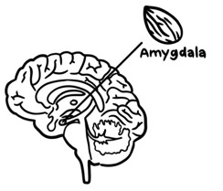
Adolescence is a great time to practice
Practising dealing with stress will make stronger connections between the prefrontal cortex (which calms stress) and the amygdala (which lets someone know when they are stressed). This helps to manage and control the stress response.
Prefrontal
cortex
Notes:
You might think that this means it might be difficult for young people to manage their stress response. And sometimes that possibly will be true. But on the other hand, this means that now is the perfect time to practice trying because young people are strengthening the connections between the prefrontal cortex and amygdala that will help the prefrontal cortex keep a handle on the amygdala activity. What's more it will be easier to strengthen these connections during this time of their life than at any other time because now is the time the prefrontal cortex is maturing.

Slide 16
Case Studies
What is the character stressed about?
How do they feel?
What is happening in their mind/body?
What strategy/
strategies are they using?
Are the strategies they're using effective? Explain your answer.
Each group will focus on one of the case studies on the worksheet: Kai, Maryam, Joe, Amber, Tia, Harry.
Discussion questions:

Slide 17
Case Studies
Kai is in Year 7. Since starting secondary school, he has found it hard to get organised. He forgets to bring things into school and get his homework done on time. He also loses things, like his PE kit. Kai has dyslexia. He can find it difficult to read long and complicated instructions and can find it hard to remember things. On a Sunday evening, he often starts to worry about the week ahead, his stomach and head hurt, and he finds it hard to sleep. He worries about getting into trouble. Sometimes he feels like a failure and can’t think of anything good about himself. He often feels a bit down and feels like nothing is any fun.
Kai

Slide 18
Case Studies
Maryam is in Year 7. She is fairly quiet in class. She doesn’t always find schoolwork easy, but really tries to give things a go and not to give up. Maryam has recently started to learn to play the saxophone. Every time she practices at home, her brother covers his ears and tells her how bad it sounds. However, if anyone says she can’t do something, she sees this as a challenge, and it makes her even more determined to do it. She’s given herself a goal of being able to play ‘Jingle Bells’ in time for Christmas and is trying to practice for 5 minutes each day. Sometimes this is hard, and she feels she isn’t making much progress, but she’s keeping going.
Maryam

Slide 19
Case Studies
Joe is in Year 7. He has been best friends with Maisie since primary school. He was pleased (and relieved) when he was put in the same form as Maisie at secondary school. Joe has begun to feel worried that Maisie doesn’t want to be his friend anymore. He feels that Maisie isn’t talking to him as much and is leaving him out of chats and activities with other people. He has tried telling Maisie how much this upsets him, but this just seems to cause arguments. He has suggested that they spend more time together just the two of them. He feels like he can’t do anything right and just wants his old friend back.
Joe

Slide 20
Case Studies
Amber is in Year 8. She is well-liked and has a couple of close friends. However, she worries a lot about friendships and what other people think of her. She is worried about looking ‘stupid’ or ‘weird’ in front of other people. She finds non-uniform days stressful, spending ages thinking about what she might wear and worrying about whether other people might laugh at her outfit or talk about her behind her back. Amber really enjoys singing and dancing and would really like to audition to be in the school production but is really worried about messing up and what other people would think if she didn’t get a part.
Amber

Slide 21
Case Studies
Tia is in Year 8. She loves athletics and playing football. She does sport at school and plays football for a local club. Tia is small for her age and some of the girls she plays football with are now quite a bit taller and stronger than her. Sometimes this makes it hard for her to out-run them or get the ball in a tackle. Recently Tia hasn’t been picked for the first team and has been substituted in a game, which has been frustrating - she has wondered whether she should just give up playing. The other evening, she couldn’t face going to football and instead said to her mum that she felt too ill to go.
Tia

Slide 22
Case Studies
Harry is in Year 8. He mostly does well at school and often puts his hand up in class to answer questions. Recently his teachers have noticed that he finds it hard to take feedback and often seems to give up and start messing about if he doesn’t understand something the first time around. For Harry, seeing himself as clever means that when he can’t get something right first time, he gets frustrated. He feels it should be easy for him to do everything.
Harry

Slide 23
Case Studies
Are there any strategies that might seem to work in the short-term but might not work in the long-term?
Which strategies are likely to work best in the long run?
Which strategies are likely to work best in the long run?
Let's think about the strategies we've seen in these six case studies....

Slide 24
Noticing your worries and your body's response to stress can help you learn how best to deal with them.
Write a few lines in the chart from your experiences in the last few weeks, to track your emotions and your body's response.
Remember the more you practice, the more you will learn.
This exercise is just for your reflection, you will not need to share your responses.
Personal reflection
Practice Makes Progress:
Learning by tracking your emotions and behaviour
Date/Time | What were you stressed about? | How did you feel? | What was happening in your body? | What did you do? | How did it go?/What happened next?
Wed, 8am | Realised I hadn’t done my homework that was due in that day | Scared and cross | My heart was beating fast, felt shaky and sick and that I was going to throw up | Instead of focusing on how bad I was feeling, I managed to do it quickly before I left for school | It was ok but I realised that I need to be more organised in the future
Notes:
Noticing worries and the body’s response to stress helps people learn how best to deal with them. Let’s consider this activity sheet which asks us to track our emotions and body's response for things we've experienced in the last few weeks. Let’s reflect on what exactly our body might have been telling us and wanting us to do to bring it back into balance. Also consider whether the behaviour that we engaged in helped or hindered us in finding balance again. Remember the more you practice, the more you will learn.

Slide 25

In summary
Learning to manage reactions to stress is hard and can sometimes feel really overwhelming – that’s completely normal!
Just remember it takes time and practice to find the stress ‘sweet spot’.
So, try to be brave!
The story of your brain – your 'neuro-story' – is still being written, and you are the author.

Slide 26
End point reflection–Revisit Student Questionnaire
Return to the "Student Questionnaire" on your Lesson 1 worksheet and fill in answers again with a different colour of pen or different symbol. You will not be asked to share your answers.

Slide 27
To be continued …
In the next session we’ll talk about learning from mistakes. We’ll look at the research that tells us why making mistakes is important and how they help people learn.

Slide 28
Support available
If you found anything we discussed today distressing, you have multiple options for support.
[INSERT SCHOOL-SPECIFIC INFO HERE]
Or contact/access online resources via:
Childline (0800 111 https://www.childline.org.uk/)
Young Minds (https://youngminds.org.uk/)
Samaritans (116 123)

Slide 29

These lessons have been developed by a team from the University of Oxford (Departments of Clinical Neuroscience, Experimental Psychology, and Psychiatry), with involvement from teachers and young people. This project was funded in part by the University of Oxford Enriching Engagement scheme, funded by Wellcome.

